Slide 1

SECP3133-01 · HIGH PERFORMANCE DATA PROCESSING
Optimizing High Performance Data Processing for Large Scale Web Crawlers
Lecturer: Assoc. Prof. Mohd Shahizan Bin Othman
Iman Abadi (A23CS0084) · Mohamed Alif Fathi (A23CS0112) · Dheshieghan (A23CS0072)

Slide 2
Background & Objectives
Target: BookXcess
Core Objectives
Dataset
Malaysian online bookstore with a large catalog across genres. Crawler parses XML sitemap and fetches product data via public .json endpoints.
Collect 100,000+ product records
Clean and preprocess raw data with pandas
Benchmark Pandas, PyArrow, and Polars
raw_data.csv: 154,714 rows
cleaned_data.csv: 147,558 rows

Slide 3
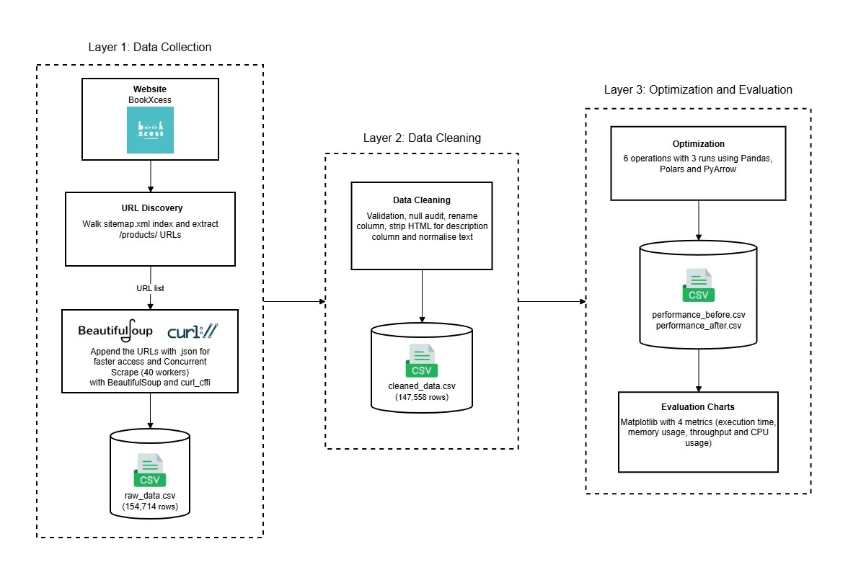
Pipeline Architecture
Four notebooks execute the pipeline: main_crawler.ipynb, clean_data.ipynb, optimize_pipeline.ipynb, and evaluation_charts.ipynb.

Slide 4
Technology Stack
HTTP & Concurrency
Parsing & Cleaning
curl_cffi mimics browser handshakes to bypass anti-bot protections. ThreadPoolExecutor with 40 workers handles I/O-bound crawling.
BeautifulSoup + lxml extracts HTML/XML. Pandas, html, and unicodedata organize and standardize data.
Optimization & Measurement
Visualization
Polars and PyArrow benchmarked against Pandas. psutil tracks CPU and memory; time.perf_counter measures execution speed.
Matplotlib transforms benchmarking data into comparative charts across four performance metrics.

Slide 5
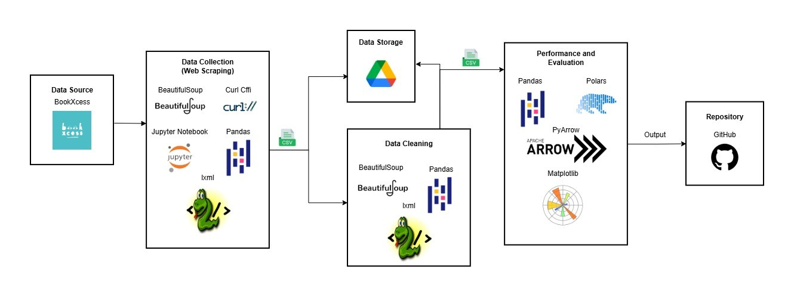
Tools Used Diagram

Slide 6
Team & Responsibilities
Mohamed Alif Fathi — Group Leader & Data Engineer
Iman Abadi — HPC & Performance Specialist
Dheshieghan — Analyst & Documentation Lead
Designed optimization benchmarks and produced comparison charts.
Performed data cleaning and analysis and guided the report and slides.
Coordinated the team, built the crawler, and managed data ingestion and storage.

Slide 7
Crawling Strategy & Reliability
Two-Phase Crawl
Reliability Measures
Phase 1 — Discovery: Walk /sitemap.xml, extract all /products/ URLs, de-duplicate
Phase 2 — Scrape: Append .json to URLs; fetch via 40-worker ThreadPoolExecutor
Per-request jitter: 50–200 ms random delay
Retry logic: Up to 3 retries with exponential backoff (1.5–3.5 s) for HTTP 429/500/502/503/504
Backup CSV: Flush every 5,000 rows to prevent data loss
Failed URL recovery: Re-scrape failures with half-sized worker pool

Slide 8
Cleaning & Transformation Steps
01
02
Drop Missing Values
Column Standardization
Remove incomplete product records.
Rename to lowercase with underscores; drop redundant currency column (all MYR).
03
04
Date Formatting
HTML Cleaning
Convert created_at to datetime.
Strip tags from body_html → plain text description.
05
06
Title & Text Normalization
Validation & Price Logic
Remove [Bargain Corner] prefix; decode HTML entities; normalize Unicode; collapse whitespace.
Validate author/publisher names; drop rows where compare_price < current_price or zero; calculate discount_pct.

Slide 9
Benchmark Operations
Six operations benchmarked across Pandas, Polars, and PyArrow — each run 3 times and averaged.
1. Filter High Discount
2. GroupBy Publisher
discount_pct > 70 AND current_price < 20
Mean price, mean discount, title count per publisher
3. String Extract
4. Calculate Savings
Regex extract "RM" price tier from tags
Derive savings_rm and savings_pct_check
5. Sort
6. Top Authors
By discount_pct (desc) and current_price (asc)
Top 20 authors by average discount

Slide 10
Benchmarking Results
Key Findings
Polars consistently fastest — Rust-based, columnar, multi-threaded
PyArrow slowest on Sort (0.183 s) — nearly 2× Pandas
Throughput: Polars peaks at 28.5M rows/s (String Extract)
Memory: Polars & PyArrow slightly more efficient via columnar storage
CPU: All under 18%; Polars most efficient at low usage

Slide 11
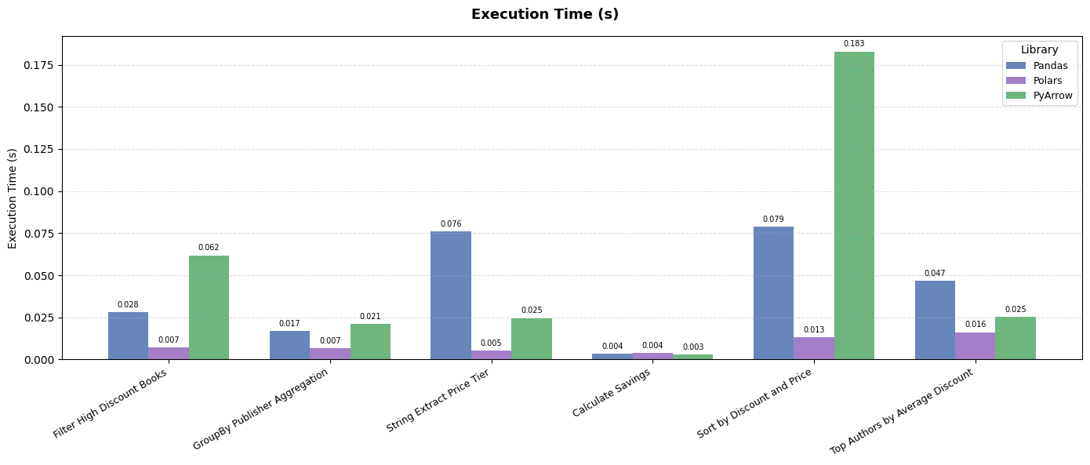
Execution Time

Slide 12
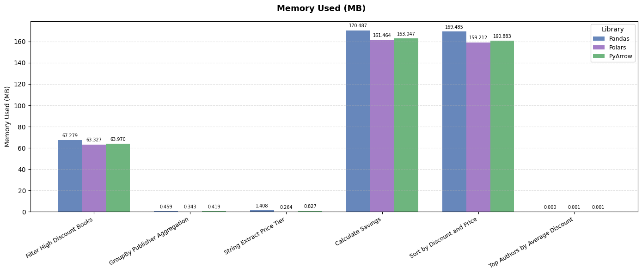
Memory Usage

Slide 13
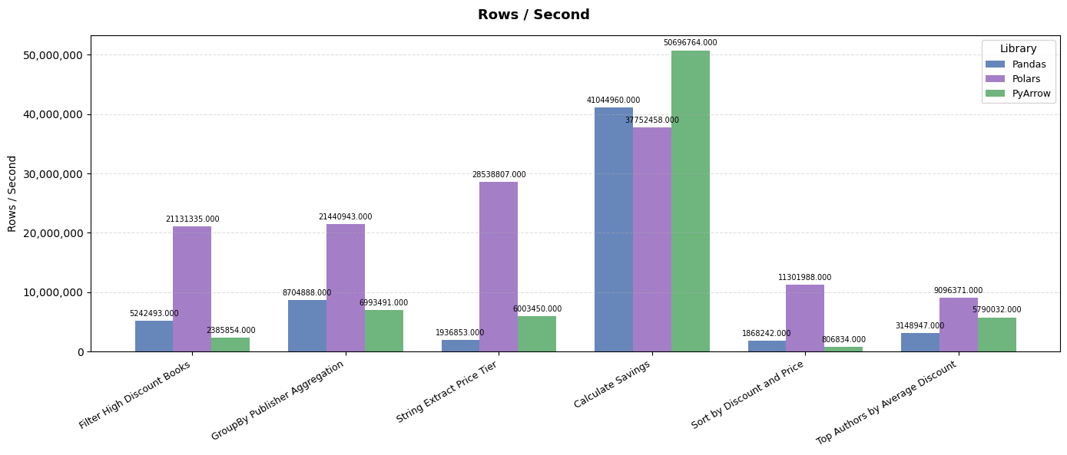
Throughput

Slide 14
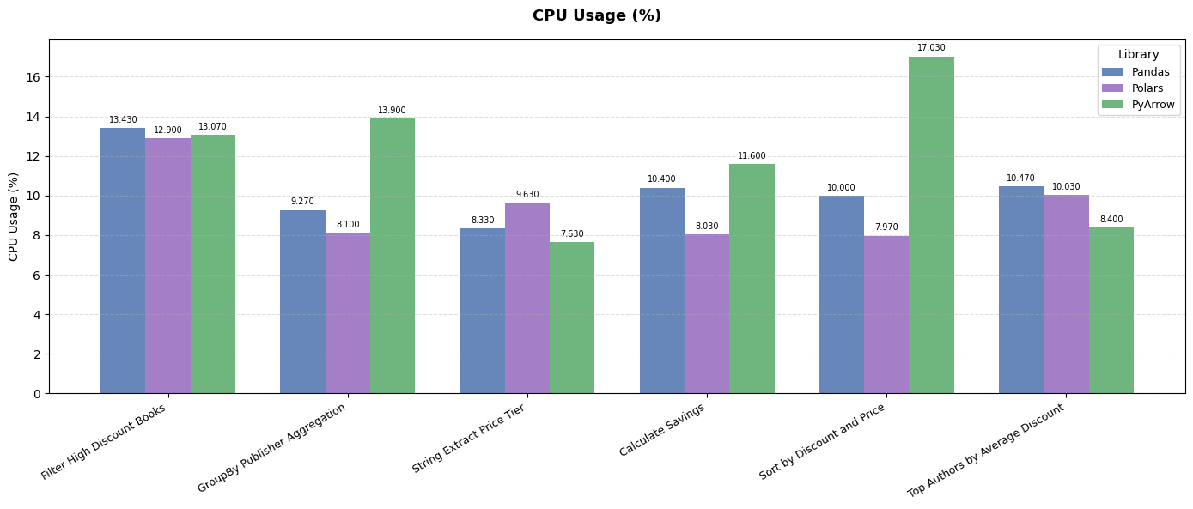
CPU Usage

Slide 15
Challenges, Findings & Future Work
Challenges
Future Improvements
Mislabeled Shopify fields ("Product Type" = author)
Anti-bot & CAPTCHA blocking automation
Noisy benchmarks required memory flush + 3-run averaging
Store in PostgreSQL / MongoDB
Use Parquet instead of CSV
Incremental crawling for new/updated products
Benchmark on 1M+ records
Build Power BI / Streamlit dashboard
Summary
154,714 → 147,558 clean records. Polars outperformed across all metrics.

